Slide 1
Data Mining & Business Intelligence
Module 6:Frequent Pattern Mining

Slide 2
Index -
Lecture 1-Knowledge of databases and Data warehouse,OLAP | 4
Lecture 2 - Introduction to Data Mining: What is Data Mining | 38
Lecture 3 - Introduction to Data Mining:: Technologies used | 50
Lecture 4 –Technologies used and issues in data mining | 59

Slide 3
Lecture 21
Association Rule Mining

Slide 4
What Is Association Mining?
Association rule mining:
  Finding frequent patterns, associations, correlations, or causal structures among sets of items or objects in transaction databases, relational databases, and other information repositories.
Applications:
  Basket data analysis, cross-marketing, catalog design, loss-leader analysis, clustering, classification, etc.
Examples.
  Rule form: “Body → Ηead [support, confidence]”.
  buys(x, “diapers”) → buys(x, “beers”) [0.5%, 60%]
  major(x, “CS”) ^ takes(x, “DB”) → grade(x, “A”) [1%, 75%]

Slide 5
Introduction to Market Basket Analysis
Def: Market Basket Analysis (Association Analysis) is a mathematical modeling technique based upon the theory that if you buy a certain group of items, you are likely to buy another group of items.
It is used to analyze the customer purchasing behavior and helps in increasing the sales and maintain inventory by focusing on the point of sale transaction data.
Given a dataset, the Apriori Algorithm trains and identifies product baskets and product association rules

Slide 6
Definitions and Terminology
Transaction is a set of items (Itemset).
Confidence : It is the measure of uncertainty or trust worthiness associated with each discovered pattern.
Support : It is the measure of how often the collection of items in an association occur together as percentage of all transactions
Frequent itemset : If an itemset satisfies minimum support,then it is a frequent itemset.
Strong Association rules: Rules that satisfy both a minimum support threshold and a minimum confidence threshold
In Association rule mining, we first find all frequent itemsets and then generate strong association rules from the frequent itemsets

Slide 7
Definitions and Terminology- Continued
Apriori algorithm is the most established algorithm for finding frequent item sets mining.
The basic principle of Apriori is “Any subset of a frequent itemset must be frequent”.
We use these frequent itemsets to generate association rules.

Slide 8
Association Rule: Basic Concepts
Given: (1) database of transactions, (2) each transaction is a list of items (purchased by a customer in a visit)
Find: all rules that correlate the presence of one set of items with that of another set of items
  E.g., 98% of people who purchase tires and auto accessories also get automotive services done
Applications
  * ⇒ Maintenance Agreement (What the store should do to boost Maintenance Agreement sales)
  Home Electronics ⇒ * (What other products should the store stocks up?)
  Attached mailing in direct marketing
  Detecting “ping-pong”ing of patients, faulty “collisions”

Slide 9
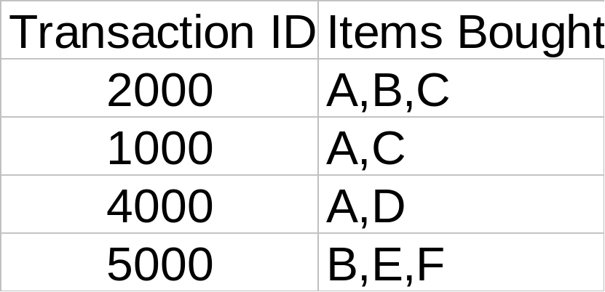
Rule Measures: Support and Confidence
Customer
buys both
Find all the rules X & Y ⇒ Z with minimum confidence and support
  support, s, probability that a transaction contains {X ∩ Y ∩ Z}
  confidence, c, conditional probability that a transaction having {X ∩ Y} also contains Z
Customer
buys diaper
Customer
buys beer
Let minimum support 50%, and minimum confidence 50%, we have
  A ⇒ C (50%, 66.6%)
  C ⇒ A (50%, 100%)

Slide 10
Association Rule Mining: A Road Map
Boolean vs. quantitative associations (Based on the types of values handled)
  buys(x, “SQLServer”) ^ buys(x, “DMBook”) → buys(x, “DBMiner”) [0.2%, 60%]
  age(x, “30..39”) ^ income(x, “42..48K”) → buys(x, “PC”) [1%, 75%]
Single dimension vs. multiple dimensional associations (see ex. Above)
Single level vs. multiple-level analysis
  What brands of beers are associated with what brands of diapers?
Various extensions
  Correlation, causality analysis
    Association does not necessarily imply correlation or causality
  Maxpatterns and closed itemsets
  Constraints enforced
    E.g., small sales (sum < 100) trigger big buys (sum > 1,000)?

Slide 11
Chapter 6: Mining Association Rules in Large Databases
Association rule mining
Mining single-dimensional Boolean association rules from transactional databases
Mining multilevel association rules from transactional databases
Mining multidimensional association rules from transactional databases and data warehouse
From association mining to correlation analysis
Constraint-based association mining
Summary

Slide 12
Lecture 22
Mining single-dimensional Boolean association rules from transactional databases

Slide 13
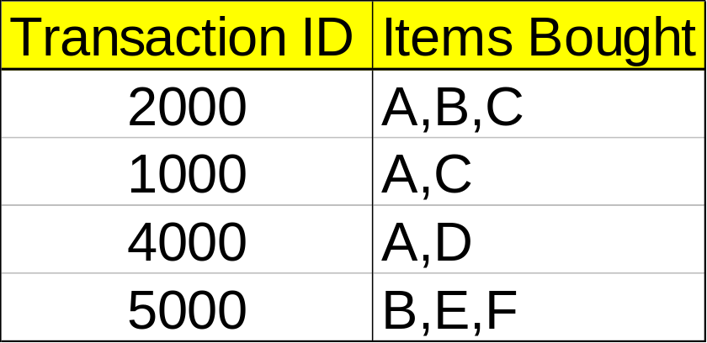
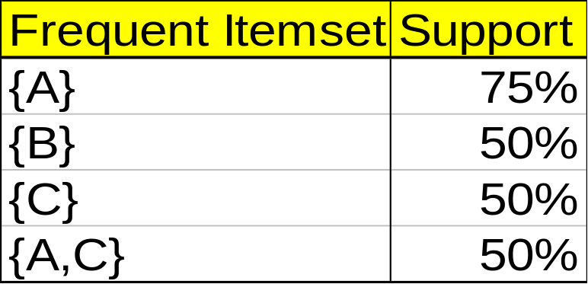
Mining Association Rules—An Example
For rule A ⇒ C:
  support = support({A ∩ C}) = 50%
  confidence = support({A ∩ C})/support({A}) = 66.6%
The Apriori principle:
  Any subset of a frequent itemset must be frequent
Min. support 50%
Min. confidence 50%

Slide 14
Mining Frequent Itemsets: the Key Step
Find the frequent itemsets: the sets of items that have minimum support
  A subset of a frequent itemset must also be a frequent itemset
    i.e., if {AB} is a frequent itemset, both {A} and {B} should be a frequent itemset
  Iteratively find frequent itemsets with cardinality from 1 to k (k-itemset)
Use the frequent itemsets to generate association rules.

Slide 15
The Apriori Algorithm
Join Step: C_{k} is generated by joining L_{k-1}with itself
Prune Step: Any (k-1)-itemset that is not frequent cannot be a subset of a frequent k-itemset
Pseudo-code:
    C_{k}: Candidate itemset of size k
    L_{k} : frequent itemset of size k
    L₁ = {frequent items};
    for (k = 1; L_{k} !=∅; k++) do begin
    C_{k+1} = candidates generated from L_{k};
    for each transaction t in database do
      increment the count of all candidates in C_{k+1} that are contained in t
    L_{k+1} = candidates in C_{k+1} with min_support
    end
    return ∪_{k} L_{k};

Slide 16








The Apriori Algorithm — Example
Database D
L₁
C₁
Scan D
C₂
C₂
L₂
Scan D
C₃
Scan D
L₃

Slide 17
How to Generate Candidates?
Suppose the items in L_{k-1} are listed in an order
Step 1: self-joining L_{k-1}
  insert into C_{k}
  select p.item₁, p.item₂, …, p.item_{k-1}, q.item_{k-1}
  from L_{k-1} p, L_{k-1} q
  where p.item₁=q.item₁, …, p.item_{k-2}=q.item_{k-2}, p.item_{k-1} < q.item_{k-1}
Step 2: pruning
  forall itemsets c in C_{k} do
    forall (k-1)-subsets s of c do
      if (s is not in L_{k-1}) then delete c from C_{k}

Slide 18
How to Count Supports of Candidates?
Why counting supports of candidates a problem?
  The total number of candidates can be very huge
  One transaction may contain many candidates
Method:
  Candidate itemsets are stored in a hash-tree
  Leaf node of hash-tree contains a list of itemsets and counts
  Interior node contains a hash table
  Subset function: finds all the candidates contained in a transaction

Slide 19
Example of Generating Candidates
L₃={abc, abd, acd, ace, bcd}
Self-joining: L₃*L₃
  abcd from abc and abd
  acde from acd and ace
Pruning:
  acde is removed because ade is not in L₃
C₄={abcd}

Slide 20
Methods to Improve Apriori’s Efficiency
Hash-based itemset counting: A k-itemset whose corresponding hashing bucket count is below the threshold cannot be frequent
Transaction reduction: A transaction that does not contain any frequent k-itemset is useless in subsequent scans
Partitioning: Any itemset that is potentially frequent in DB must be frequent in at least one of the partitions of DB
Sampling: mining on a subset of given data, lower support threshold + a method to determine the completeness
Dynamic itemset counting: add new candidate itemsets only when all of their subsets are estimated to be frequent

Slide 21
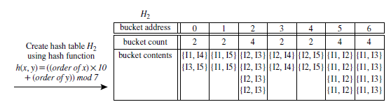
Hash Based Technique
Hash-based technique (hashing itemsets into corresponding buckets): A hash-based
technique can be used to reduce the size of the candidate k-itemsets, Ck, for k > 1.
For example, when scanning each transaction in the database to generate the frequent
1-itemsets, L1, we can generate all the 2-itemsets for each transaction, hash (i.e., map)
Lecture 1-Knowledge of database, data warehouse, OLAP

Slide 22
them into the different buckets of a hash table structure, and increase the corresponding
bucket counts (Figure 6.5). A 2-itemset with a corresponding bucket count in the
hash table that is below the support threshold cannot be frequent and thus should
be removed from the candidate set. Such a hash-based technique may substantially
reduce the number of candidate k-itemsets examined (especially when k D 2).
Lecture 1-Knowledge of database, data warehouse, OLAP

Slide 23
Generating Rules from Frequent Itemsets
For each set S belonging to the frequent itemset: generate rules that contain all the items in S and test if they satisfy the confidence constraint:
Approach: Generate all possible rules (approach described in Han’s book); e.g. for {D,E,F} the following candidate rules are created: E→DF, D→EF, F→ED, DF→E, EF→D, ED→F

Slide 24

Visualization of Association Rule Using Plane Graph

Slide 25

Visualization of Association Rule Using Rule Graph

Slide 26
Chapter 6: Mining Association Rules in Large Databases
Association rule mining
Mining single-dimensional Boolean association rules from transactional databases
Mining multilevel association rules from transactional databases
Mining multidimensional association rules from transactional databases and data warehouse
From association mining to correlation analysis
Constraint-based association mining
Summary

Slide 27
Introduction
Apriori: uses a generate-and-test approach – generates candidate itemsets and tests if they are frequent
  Generation of candidate itemsets is expensive(in both space and time)
  Support counting is expensive
    Subset checking (computationally expensive)
    Multiple Database scans (I/O)
FP-Growth: allows frequent itemset discovery without candidate itemset generation. Two step approach:
  Step 1: Build a compact data structure called the FP-tree
    Built using 2 passes over the data-set.
  Step 2: Extracts frequent itemsets directly from the FP-tree

Slide 28
Step 1: FP-Tree Construction
FP-Tree is constructed using 2 passes over the data-set:
Pass 1:
  Scan data and find support for each item.
  Discard infrequent items.
  Sort frequent items in decreasing order based on their support.
Use this order when building the FP-Tree, so common prefixes can be shared.

Slide 29
Step 1: FP-Tree Construction
Pass 2:
Nodes correspond to items and have a counter
FP-Growth reads 1 transaction at a time and maps it to a path
Fixed order is used, so paths can overlap when transactions share items (when they have the same prefix ).
  In this case, counters are incremented
Pointers are maintained between nodes containing the same item, creating singly linked lists (dotted lines)
  The more paths that overlap, the higher the compression. FP-tree may fit in memory.
Frequent itemsets extracted from the FP-Tree.

Slide 30
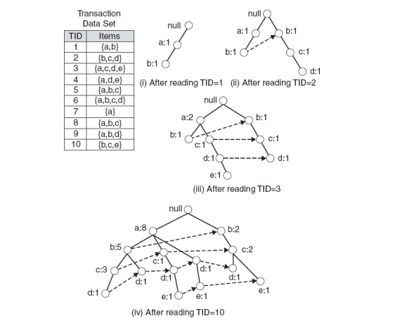
Step 1: FP-Tree Construction (Example)

Slide 31
FP-Tree size
The FP-Tree usually has a smaller size than the uncompressed data - typically many transactions share items (and hence prefixes).
  Best case scenario: all transactions contain the same set of items.
    1 path in the FP-tree
  Worst case scenario: every transaction has a unique set of items (no items in common)
    Size of the FP-tree is at least as large as the original data.
    Storage requirements for the FP-tree are higher - need to store the pointers between the nodes and the counters.
The size of the FP-tree depends on how the items are ordered
Ordering by decreasing support is typically used but it does not always lead to the smallest tree (it's a heuristic).

Slide 32
Step 2: Frequent Itemset Generation
FP-Growth extracts frequent itemsets from the FP-tree.
Bottom-up algorithm - from the leaves towards the root
Divide and conquer: first look for frequent itemsets ending in e, then de, etc. . . then d, then cd, etc. . .
First, extract prefix path sub-trees ending in an item(set). (hint: use the linked lists)

Slide 33
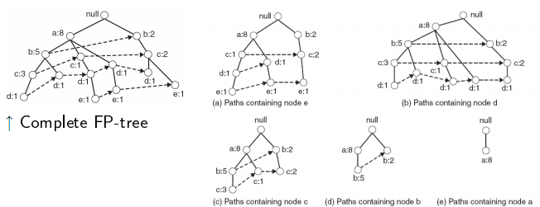
Prefix path sub-trees (Example)

Slide 34
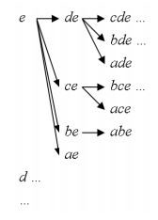
Step 2: Frequent Itemset Generation
Each prefix path sub-tree is processed recursively to extract the frequent itemsets. Solutions are then merged.
  E.g. the prefix path sub-tree for e will be used to extract frequent itemsets ending in e, then in de, ce, be and ae, then in cde, bde, cde, etc.
  Divide and conquer approach

Slide 35
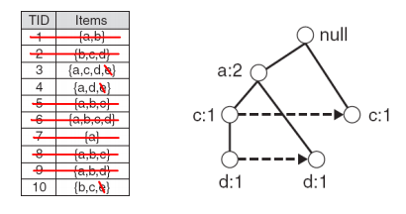
Conditional FP-Tree
The FP-Tree that would be built if we only consider transactions containing a particular itemset (and then removing that itemset from all transactions).
I Example: FP-Tree conditional on e.

Slide 36
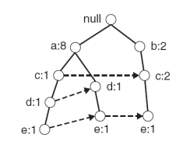
Example
Let minSup = 2 and extract all frequent itemsets containing e.
1. Obtain the prefix path sub-tree for e:

Slide 37
Example
2. Check if e is a frequent item by adding the counts along the linked list (dotted line). If so, extract it.
  Yes, count =3 so {e} is extracted as a frequent itemset.
3. As e is frequent, find frequent itemsets ending in e. i.e. de, ce, be and ae.

Slide 38
Example
4. Use the the conditional FP-tree for e to find frequent itemsets ending in de, ce and ae
  Note that be is not considered as b is not in the conditional FP-tree for e.
I For each of them (e.g. de), find the prefix paths from the conditional tree for e, extract frequent itemsets, generate conditional FP-tree, etc... (recursive)

Slide 39
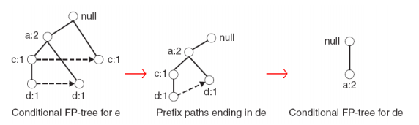
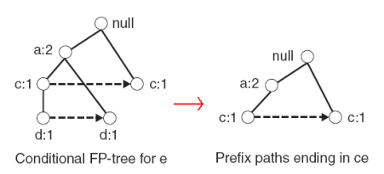
Example
Example: e -> de -> ade ({d,e}, {a,d,e} are found to be frequent)
Example: e -> ce ({c,e} is found to be frequent)

Slide 40
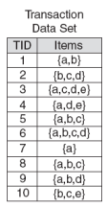
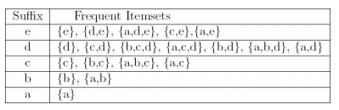
Result
Frequent itemsets found (ordered by sufix and order in which they are found):

Slide 41
Discusion
Advantages of FP-Growth
  only 2 passes over data-set
  “compresses” data-set
  no candidate generation
  much faster than Apriori
Disadvantages of FP-Growth
  FP-Tree may not fit in memory!!
  FP-Tree is expensive to build

Slide 42
Pattern-Growth Approach: Mining Frequent Patterns Without Candidate Generation
The FP-Growth Approach
  Depth-first search (Apriori: Breadth-first search)
  Avoid explicit candidate generation
FP-Growth approach:
For each frequent item, construct its conditional pattern-base, and then its conditional FP-tree
Repeat the process on each newly created conditional FP-tree
Until the resulting FP-tree is empty, or it contains only one path—single path will generate all the combinations of its sub-paths, each of which is a frequent pattern
Fp-tree construatioin:
Scan DB once, find frequent 1-itemset (single item pattern)
Sort frequent items in frequency descending order, f-list
Scan DB again, construct FP-tree

Slide 43
FP-tree Size
The size of an FP­tree is typically smaller than the size of the uncompressed data because many transactions often share a few items in common
  Best­case scenario: All transactions have the same set of items, and the FP­tree contains only a single branch of nodes.
  Worst­case scenario: Every transaction has a unique set of items. As none of the transactions have any items in common, the size of the FP­tree is effectively the same as the size of the original data.
The size of an FP­tree also depends on how the items are ordered

Slide 44
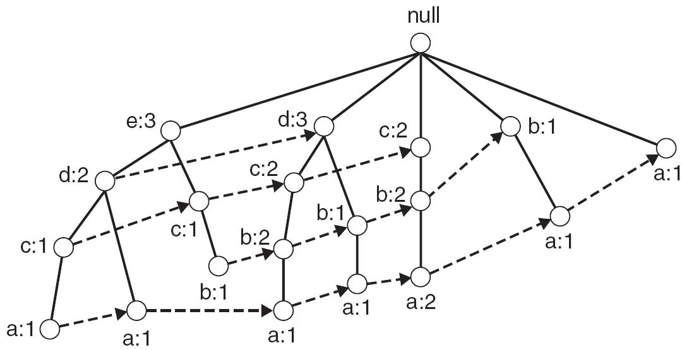
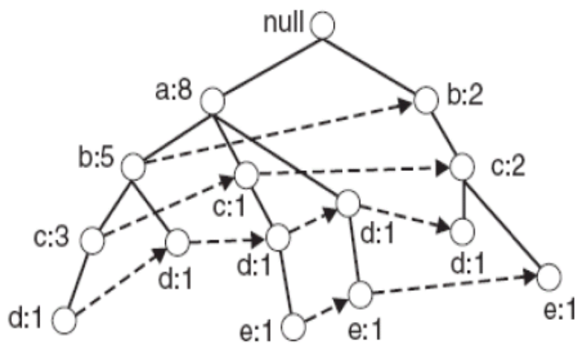
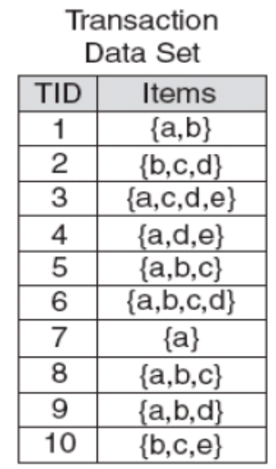
Example
FP-tree with item ascending ordering
FP-tree with item descending ordering

Slide 45
Find Patterns Having p From P-conditional Database
Starting at the frequent item header table in the FP-tree
Traverse the FP-tree by following the link of each frequent item p
Accumulate all of transformed prefix paths of item p to form p’s conditional pattern base
{}
Header Table
Item frequency head
f 4
c 4
a 3
b 3
m 3
p 3
f:4
c:1
Conditional pattern bases
item cond. pattern base
c f:3
a fc:3
b fca:1, f:1, c:1
m fca:2, fcab:1
p fcam:2, cb:1
c:3
b:1
b:1
a:3
p:1
m:2
b:1
p:2
m:1

Slide 46
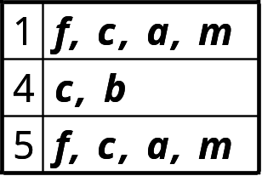
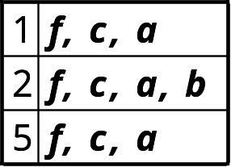
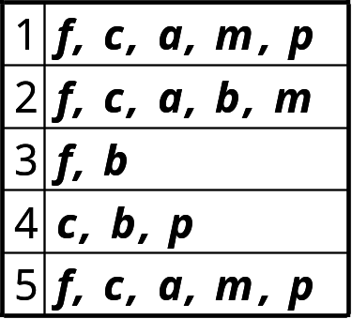
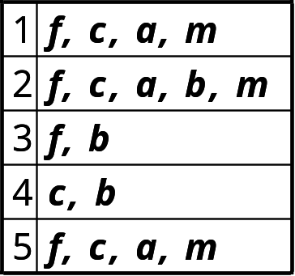
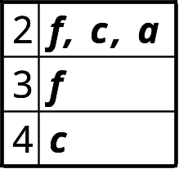
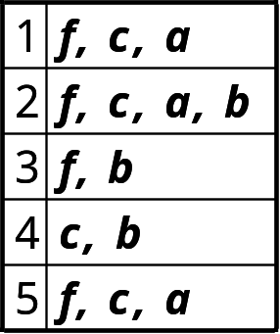
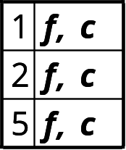
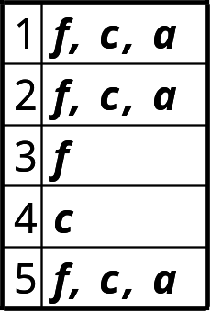
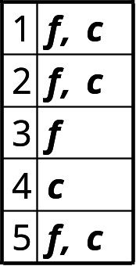
FP-Growth
+ p
+ m
+ b
+ a

Slide 47
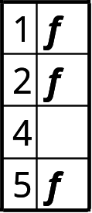
FP-Growth
+ p
+ m
(1)
(2)
+ b
+ a
(3)
(4)
+ c
f: 1,2,3,5
(6)
(5)

Slide 48
{}
{}
f:2
c:1
f:3
c:2
b:1
c:3
{}
a:2
p:1
a:3
f:4
c:1
+ p
b:1
+ m
m:2
c:3
b:1
b:1
(1)
(2)
a:3
p:1
{}
{}
{}
m:2
b:1
f:2
c:1
f:3
f:4
f:3
p:2
m:1
c:1
c:3
+ c
+ a
+ b
a:1
(3)
(4)
(5)
(6)

Slide 49
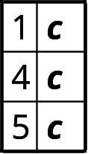
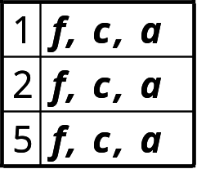
+ p
p: 3
cp: 3
+ p
+ m
m: 3
fm: 3
cm: 3
am: 3
fcm: 3
fam: 3
cam: 3
fcam: 3
min_sup = 3
+ m
+ b
b: 3
a: 3
fa: 3
ca: 3
fca: 3
+ a
c: 4
fc: 3
+ c
f: 1,2,3,5
f: 4

Slide 50
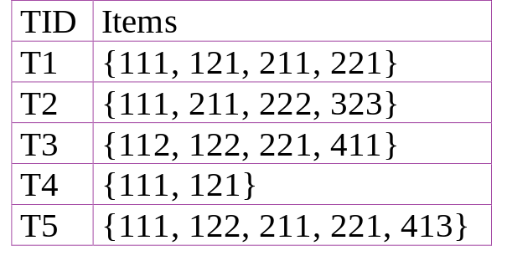
Multiple-Level Association Rules
Food
Items often form hierarchy.
Items at the lower level are expected to have lower support.
Rules regarding itemsets at
appropriate levels could be quite useful.
Transaction database can be encoded based on dimensions and levels
We can explore shared multi-level mining
milk
bread
skim
2%
wheat
white
Fraser
Sunset

Slide 51
Mining Multi-Level Associations
A top_down, progressive deepening approach:
  First find high-level strong rules:
milk → bread [20%, 60%].
  Then find their lower-level “weaker” rules:
2% milk -→ wheat bread [6%, 50%].
Variations at mining multiple-level association rules.
  Level-crossed association rules:
  2% milk → Wonder wheat bread
  Association rules with multiple, alternative hierarchies:
  2% milk → Wonder bread

Slide 52
Multi-level Association: Uniform Support vs. Reduced Support
Two approaches of Multilevel association rule
Uniform Support: the same minimum support for all levels
  + One minimum support threshold. No need to examine itemsets containing any item whose ancestors do not have minimum support.
  – Lower level items do not occur as frequently. If support threshold
    too high ⇒ miss low level associations
    too low ⇒ generate too many high level associations
Reduced Support: reduced minimum support at lower levels
  There are 4 search strategies:
    Level-by-level independent
    Level-cross filtering by k-itemset
    Level-cross filtering by single item
    Controlled level-cross filtering by single item

Slide 53
Uniform Support
Multi-level mining with uniform support
Level 1
min_sup = 5%
Milk
[support = 10%]
Level 2
min_sup = 5%
2% Milk
[support = 6%]
Skim Milk
[support = 4%]
Back

Slide 54
Reduced Support
Multi-level mining with reduced support
Level 1
min_sup = 5%
Milk
[support = 10%]
Level 2
min_sup = 3%
2% Milk
[support = 6%]
Skim Milk
[support = 4%]
Back

Slide 55
Reduced Support Strategies
Level-by-level independent
  Full Breadth Search Method
  The parent node is checked whether it is frequent or not and based on that node is examined
Level-cross filtering by k-itemset
  The children of only frequent nodes are checked
Level-cross filtering by single item
  Find the frequent K-items at the parent level
  Only the k items at next level is checked
Controlled level-cross filtering by single item
  This is modified version of Level-cross filtering by single item
  Some minimum support threshold is set for for lower level.
  So the items which do not satisfy minimum support are checked for minimum support threshold this is also called “Level passage Threshold”
Lecture 1-Knowledge of database, data warehouse, OLAP

Slide 56
Multi-Dimensional Association: Concepts
Single-dimensional rules: only one distinct predicate
    buys(X, “milk”) ⇒ buys(X, “bread”)
Multi-dimensional rules:  2 dimensions or predicates
  Inter-dimension association rules (no repeated predicates)
    age(X,”19-25”) ∧ occupation(X,“student”) ⇒ buys(X,“coke”)
  hybrid-dimension association rules (repeated predicates)
    age(X,”19-25”) ∧ buys(X, “popcorn”) ⇒ buys(X, “coke”)
Categorical Attributes
  finite number of possible values, no ordering among values. Example color ,brand.
Quantitative Attributes.
  numeric, implicit ordering among values
  Example-Age,Income.

Slide 57
Techniques for Mining MD Associations
Search for frequent k-predicate set:
  Example: {age, occupation, buys} is a 3-predicate set.
  Techniques can be categorized by how age are treated.
1. Using static discretization of quantitative attributes
  Quantitative attributes are statically discretized by using predefined concept hierarchies.
2. Quantitative association rules
  Quantitative attributes are dynamically discretized into “bins”based on the distribution of the data.
3. Distance-based association rules
  This is a dynamic discretization process that considers the distance between data points.

Slide 58
Static Discretization of Quantitative Attributes
Discretized prior to mining using concept hierarchy.
Numeric values are replaced by ranges.
In relational database, finding all frequent k-predicate sets will require k or k+1 table scans.
Data cube is well suited for mining.
The cells of an n-dimensional
  cuboid correspond to the
  predicate sets.
Mining from data cubes
can be much faster.
()
(age)
(income)
(buys)
(age, income)
(age,buys)
(income,buys)
(age,income,buys)

Slide 59
Quantitative Association Rules
Numeric attributes are dynamically discretized
  Such that the confidence or compactness of the rules mined is maximized.
2-D quantitative association rules: A_{quan1} ∧ A_{quan2} ⇒ A_{cat}
Cluster “adjacent”
  association rules
  to form general
  rules using a 2-D
  grid.
Example:
age(X,”30-34”) ∧ income(X,”24K - 48K”)
⇒ buys(X,”high resolution TV”)

Slide 60

ARCS (Association Rule Clustering System)
How does ARCS work?
1. Binning(Equi Width Binning)-same interval size.
2. Find frequent predicate set-Satisfy Minimum support and confidence
3. Clustering-Strong association rule is mapped to 2 D grid
age(X,”30-34”) ∧ income(X,”24K - 48K”)
⇒ buys(X,”high resolution TV”)

Slide 61
Limitations of ARCS
Only quantitative attributes on LHS of rules.
Only 2 attributes on LHS. (2D limitation)
.

Slide 62
Mining Distance-based Association Rules
Distance-based partitioning, more meaningful discretization considering
Two Steps
  density/number of points in an interval
  “closeness” of points in an interval
  The resultant rule of this method must satisfy:
  Cluster in the rule antecedent are strongly associated with cluster of the rules in consequent.
  Clusters in the antecedent occur together
  Clusters in the consequent occur together

Slide 63
Interestingness Measurements
Objective measures
  Two popular measurements:
  support; and
  confidence
Subjective measures (Silberschatz & Tuzhilin, KDD95)
  A rule (pattern) is interesting if
  it is unexpected (surprising to the user); and/or
  actionable (the user can do something with it)

Slide 64
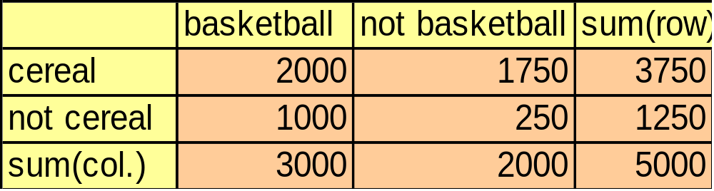
Criticism to Support and Confidence
Example 1: (Aggarwal & Yu, PODS98)
  Among 5000 students
    3000 play basketball
    3750 eat cereal
    2000 both play basket ball and eat cereal
  play basketball ⇒ eat cereal [40%, 66.7%] is misleading because the overall percentage of students eating cereal is 75% which is higher than 66.7%.
  play basketball ⇒ not eat cereal [20%, 33.3%] is far more accurate, although with lower support and confidence

Slide 65
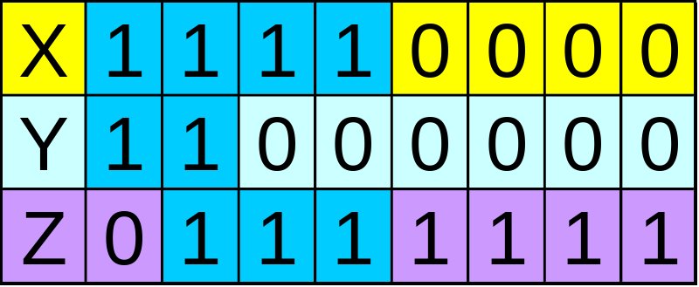
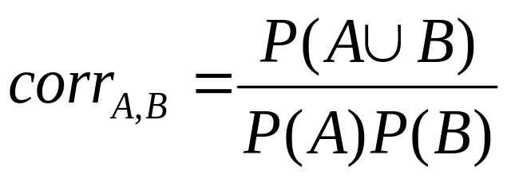
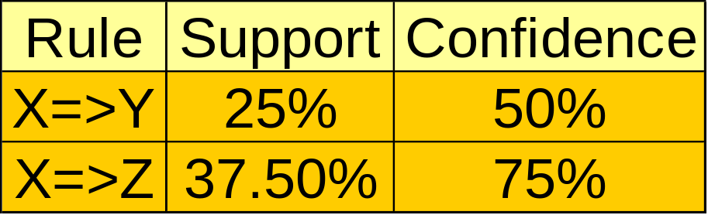
Criticism to Support and Confidence (Cont.)
Example 2:
  X and Y: positively correlated,
  X and Z, negatively related
  support and confidence of
  X=>Z dominates
We need a measure of dependent or correlated events
P(B|A)/P(B) is also called the lift of rule A => B

Slide 66
From Association Mining to Correlation analysis
The support and confidence measures are insufficient at filtering out uninteresting association rules.
To tackle this weakness, a correlation measure can be used to augment the support–confidence framework for association rules.
This leads to correlation rules of the form
A →B [support, confidence, correlation].
That is, a correlation rule is measured not only by its support and confidence but also by the correlation between itemsets A and B.
There are many different correlation measures from which to choose
Lecture 1-Knowledge of database, data warehouse, OLAP

Slide 67
Interestingness Measure: Correlations (Lift)
Lift is a simple correlation measure that is given as follows.
The occurrence of itemset
A is independent of the occurrence of itemset B if P.A [B/ D P.A/P.B/; otherwise,
itemsets A and B are dependent and correlated as events. This definition can easily be
extended to more than two itemsets. The lift between the occurrence of A and B can be
measured by computing
Lecture 1-Knowledge of database, data warehouse, OLAP

Slide 68



Interestingness Measure: Correlations (Lift)
play basketball ⇒ eat cereal [40%, 66.7%] is misleading
  The overall % of students eating cereal is 75% > 66.7%.
play basketball ⇒ not eat cereal [20%, 33.3%] is more accurate, although with lower support and confidence
Measure of dependent/correlated events: lift
 | Basketball | Not basketball | Sum (row)
Cereal | 2000 | 1750 | 3750
Not cereal | 1000 | 250 | 1250
Sum(col.) | 3000 | 2000 | 5000
Lecture 36 - Frequent Pattern Mining :: Interestingness Measure: Correlations

Slide 69
Constraint-Based Mining
Interactive, exploratory mining giga-bytes of data?
  Could it be real? — Making good use of constraints!
What kinds of constraints can be used in mining?
  Knowledge type constraint: classification, association, etc.
  Data constraint: SQL-like queries
    Find product pairs sold together in Vancouver in Dec.’98.
  Dimension/level constraints:
    in relevance to region, price, brand, customer category.
  Rule constraints
    small sales (price < $10) triggers big sales (sum > $200).
  Interestingness constraints:
    strong rules (min_support ≥ 3%, min_confidence ≥ 60%).

Slide 70
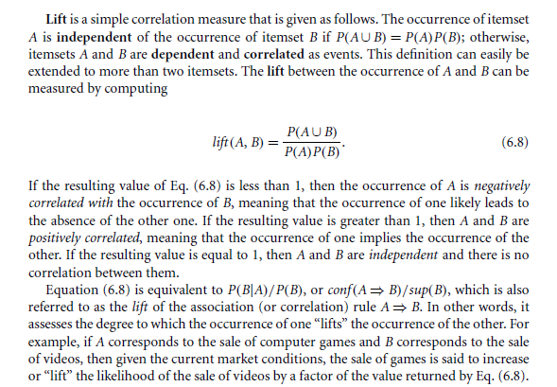
Lecture 1-Knowledge of database, data warehouse, OLAP

Slide 71
Rule Constraints in Association Mining
Two kind of rule constraints:
  Rule form constraints: meta-rule guided mining.
    P(x, y) ^ Q(x, w) -→ takes(x, “database systems”).
  Rule (content) constraint: constraint-based query
    sum(LHS) < 100 ^ min(LHS) > 20 ^ count(LHS) > 3 ^ sum(RHS) > 1000
1-variable vs. 2-variable constraints (Lakshmanan, et al. SIGMOD’99):
  1-var: A constraint confining only one side (L/R) of the rule, e.g., as shown above.
  2-var: A constraint confining both sides (L and R).
    sum(LHS) < min(RHS) ^ max(RHS) < 5* sum(LHS)

Slide 72
Constrained Association Query Optimization Problem
Given a CAQ = { (S1, S2) | C }, the algorithm should be :
  sound: It only finds frequent sets that satisfy the given constraints C
  complete: All frequent sets satisfy the given constraints C are found
A naïve solution:
  Apply Apriori for finding all frequent sets, and then to test them for constraint satisfaction one by one.
Our approach:
  Comprehensive analysis of the properties of constraints and try to push them as deeply as possible inside the frequent set computation.’

Slide 73
Thank You

